Slide 1
COVID-19 Phase 3.1
October 1, 2020

Slide 2
Milestone: Average Daily Cases
50 case threshold is consistent with nationally recognized standards.
Notes:
Why is the threshold 50? (again)
Around 90% of peak
Close to 10case/100K threshold (see next slide)
Based on testing threshold of 5% population per month (initial guidance), 50 cases would be below 10% positivity rate (initial WH/CDC guidance)

Slide 3
Milestone: Testing Capacity
Testing capacity remains significantly above target.

Slide 4
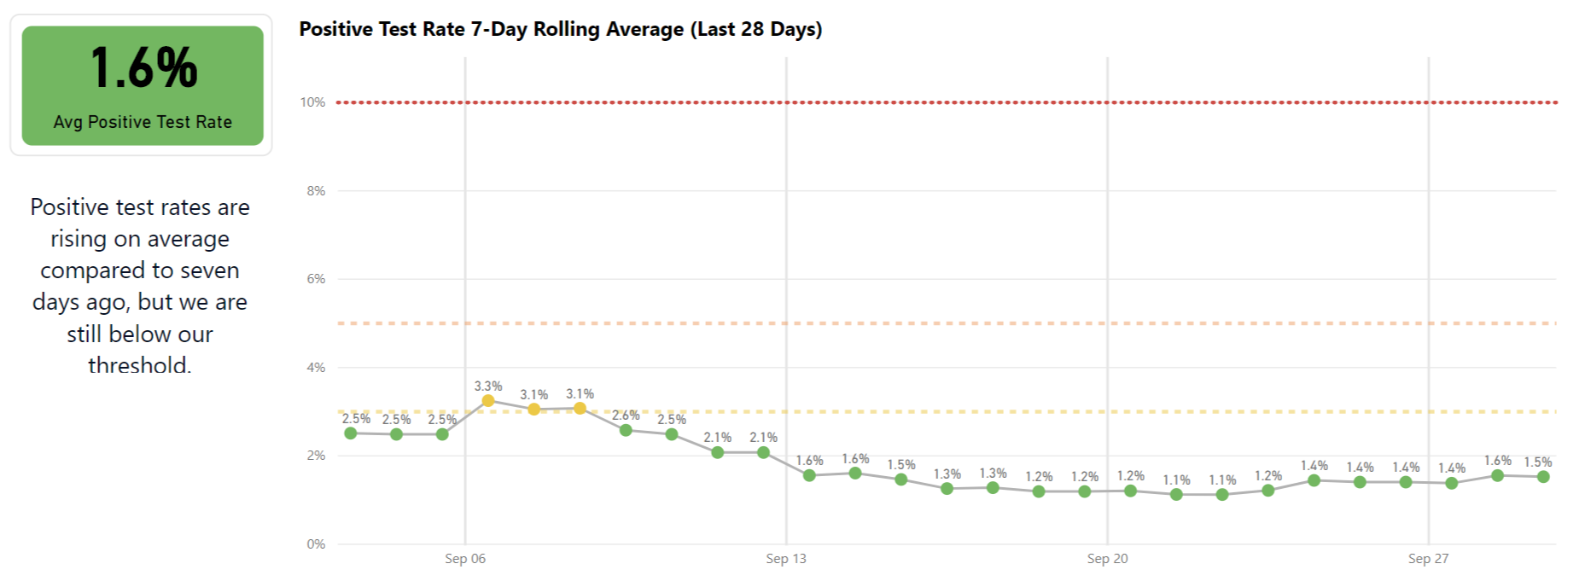
Milestone: Positivity Rate
Positivity rate is declining and is under key threshold of 5%.
5%

Slide 5
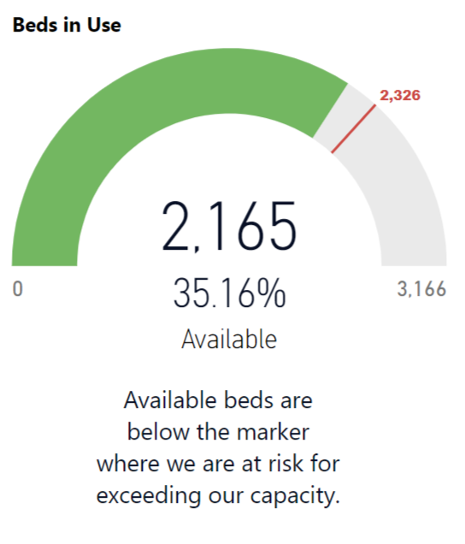
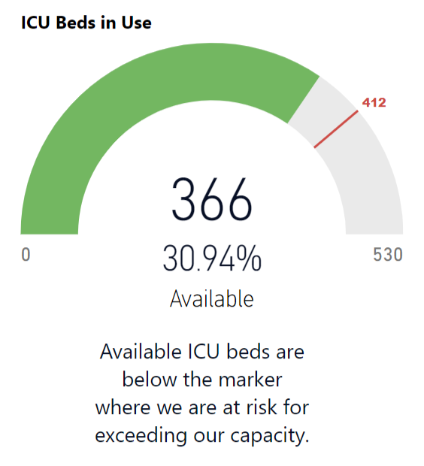
Milestone: Hospital Capacity
Region 1 hospitals have capacity.
Notes:
15 hospitals statewide have zero ICU beds, which is leading to crowding elsewhere. Staffing shortages affecting hospitals across the state as well.

Slide 6
Phase Three Considerations
Key factors in policy making
Outdoor activities are safer than indoor activities
Timed, seated events are safer than uncontrolled gatherings
Some indoor activities have not been linked to significant public outbreak
Policies should not increase health or economic inequities

Slide 7
Staged Approach
Time between each stage to evaluate the impacts of easing restrictions.

Slide 8
Tenets of Disease Control
Phase Three is only possible with the continued practice of disease control.
Masks
Social Distancing
Handwashing
Disinfecting Surfaces

Slide 9
Phase 3.1 Details
Alcohol Sales
Gathering Sizes
75% Capacity with Social Distancing
Bars allowed to sell to-go drinks from 8 a.m. to 11 p.m.
Indoor: 50 people
Outdoor: 100 people
Package liquor sales in the French Quarter limited to 8 a.m. through 11 p.m.
Beauty salons, barber shops, and nail salons
Libraries
Museums, zoos, aquariums
Office buildings and businesses
Restaurants
Shopping malls and retail stores
Tattoo, massage, and esthetician services
Enhanced Outdoor Seating Options
Sidewalk Café Outdoor Dining Grant
Curbside Dining and Parklet Pilot
Safe and Social French Market Place

Slide 10
COVID-19 Phase 3.1
October 1, 2020

